Slide 1
February 4th
Parkinson’s disease
Alpha-synuclein

Slide 2
Parkinson’s disease
First described by James Parkinson in his “Essay on Shaking Palsy” (Paralysis-agitans; 1817).
Neurodegenerative disease characterized by the loss of dopaminergic neurons in the Substantia Nigra pars compact (SNpc) and by the accumulation of intracellular fibrillar aggregates, the Lewy Bodies.
PD is the second most common neurodegenerative disease, after AD, encountered with aging.
95% of the cases are sporadic, only 5% are genetically inherited.
Because of the impact of environmental toxins in PD, developed, industrial countries have an higher incidence of PD cases, compared to undeveloped, non industrialized countries. Differences in the PD diagnosis among countries could also be due to different diagnostic methods, treatments and follow ups.
Medium age of onset is after 60 years old (for sporadic PD). About 1% of the population of 60 years old is affected by PD.

Slide 3
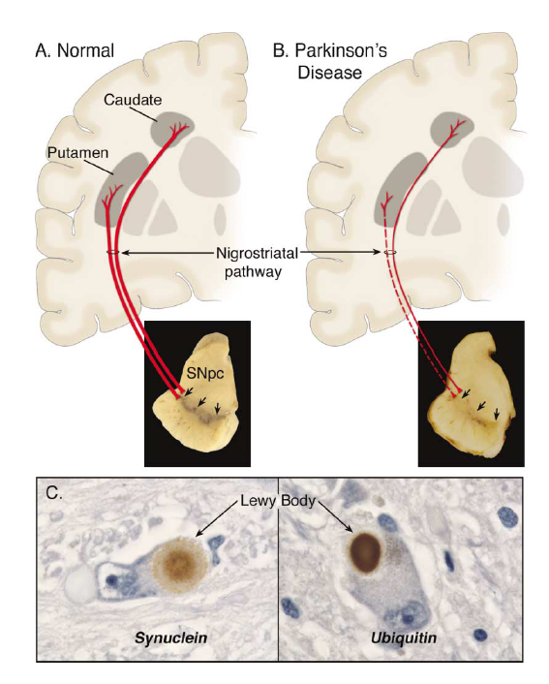
SNpc degeneration in PD
Dauer & Przedborski, 2003, Neuron 39, 889-909

Slide 4
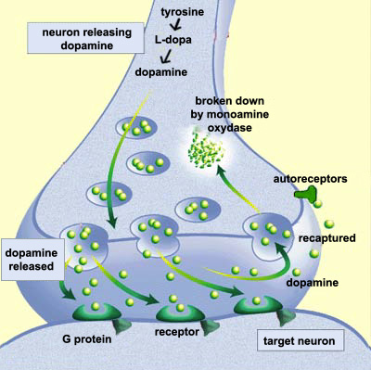
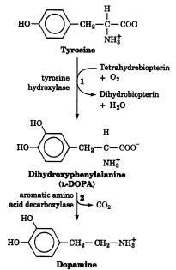
Dopamine synthesis and signaling

Slide 5
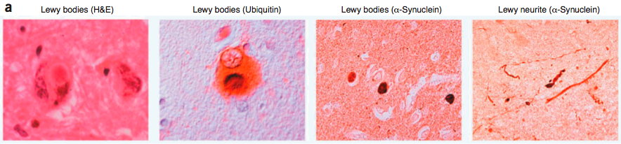
Deposition of fibrillar proteinacious material in PD
Parkinson’s disease: characterized by dopaminergic neuronal loss and by intracellular depositions, the Lewy bodies, comprised of α-synuclein and ubiquitin, as the major components. Other components are proteasome and cytoskeletal proteins and other proteins that interact with α-synuclein.
Bossy-Wetzel E, et al., Nat Med. 2004 Jul;10 Suppl:S2-9. Review.

Slide 6
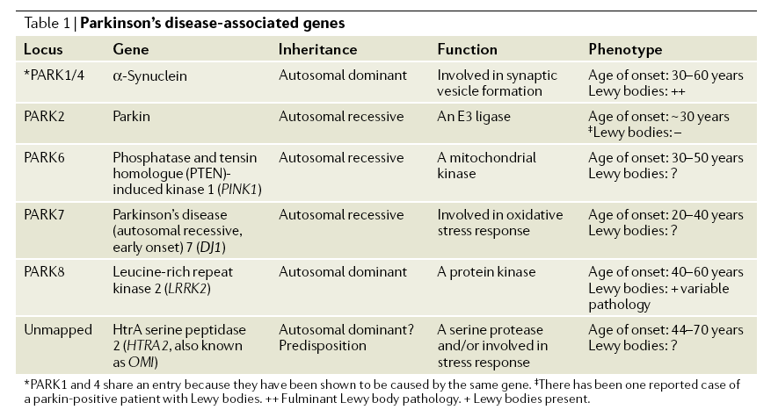
Proteins genetically mutated in inherited PD:
role and onset of the disease

Slide 7
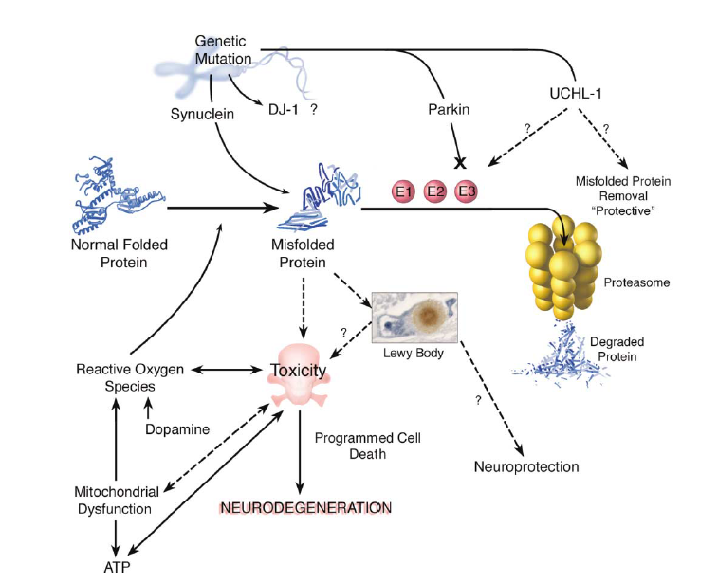
Mechanisms in PD:
environmental and genetic factors
Dauer & Przedborski, 2003, Neuron 39, 889-909

Slide 8
α-synuclein (PARK1/4)
1-Belonging to the family of the synucleins, existing in three forms: α-synuclein, β-synuclein and γ-synuclein. Although they all colocalize in the presynaptic terminal, only α-synuclein accumulates in Lewy bodies.
2- α-synuclein gene is expressed on chromosome 4.
3-Cytosolic protein of 140 aa, approximate molecular weight 14.5 kDa.
4-Mostly expressed at a neuronal level, in presynaptic terminals.
5-It is degraded through the UPP and autophagy.
6-It exists in 2 different conformations α-helix and β-sheet.
7-Its function is still unknown. Probably involved in neurites development and in dopaminergic signaling.
8-Two mutations account for inherited forms of autosomal dominant
PD (A53T; A30P).

Slide 9
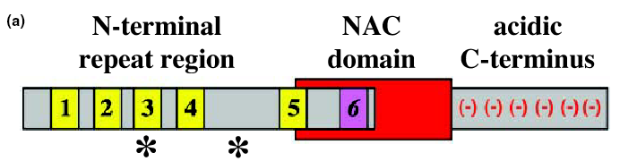
α-synuclein
aa90
aa 121
A30P
A53T
A30P
A53T
In the N-terminal region there are 5-6 imperfect repeats (EKTKEGV). This region acquires α-helical secondary structure upon binding to membrane lipids, whereas the C-terminal region is highly flexible (Eliezer, 2001).
NAC=non amyloid component, in this hydrophobic region are aa crucial for α-synuclein aggregation.
Kahle et al.,

Slide 10
Physiological role of α-synuclein
1- α-synuclein is expressed in neuronal tissues, brain and spinal cord, not in muscles and other organs (Maroteaux, 1988).
2- α-synuclein associates with lipid membranes.
In nervous system α-synuclein is found in close association with synaptic vesicles, where it may modulate synaptic vesicle function (Kahle 2002), by binding to the lipid component of the vesicles and regulating vesicles and protein trafficking (Jensen, 1998, 1999, 2000) probably through modulation of phospholipase D activity. This binding stabilizes the α-helical conformations of the N-terminal domain of α-synuclein (Davidson 1998, Eliezer, 2001).
3- In dopaminergic neurons, α-synuclein may regulate the pool of DA released in the cytosol.

Slide 11
Pathogenic mechanisms of α-synuclein
1- Docking of α-synuclein with oxidized DA (DA quinone), and formation of protofibrils.
2-Formation of protofibrils sequesters α-synuclein available to bind to synaptic vesicles, thus the amount of α-synuclein in the α-helical structure decreases.
3- Mis-regulation of the amount of DA released in the cell.

Slide 12
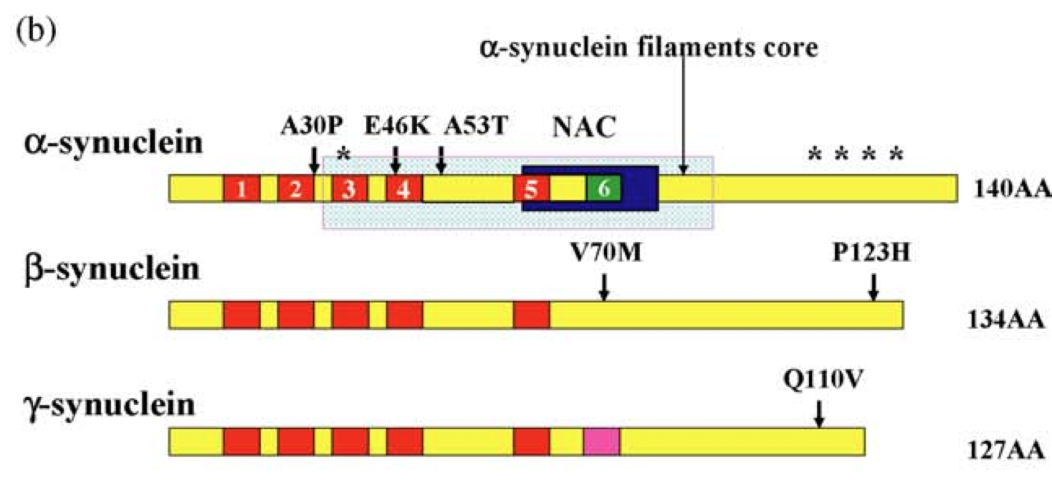
α, β, γ- synucleins

Slide 13
Loss of physiological function
Gain of toxic function
α-syn does not bind to membranes, no control on dopamine release
Formation of aggregates
fibrils or oligomers

Slide 14
α-synuclein in PD:
Pathologic function both in familial and sporadic PD
-All α-synuclein inherited mutations lead to dominant forms of PD
-WT α-synuclein binds to DA quinone and forms protofibrils in sporadic PD
Is aggregation playing a role in α-synuclein-mediated toxicity?
Are α-synuclein aggregates TOXIC?

Slide 15
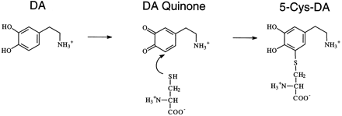
Oxidation of Dopamine and subsequent interaction with α-synuclein or with Cys residues on different substrates: first step to the formation of Protofibrils
O₂
α-synuclein
on Tyr, Met or Lys
+ H₂O₂ + O₂⁻

Slide 16
α-synuclein mutations (PARK1/4)
A53T, A30P and E46K: TOXIC GAIN OF FUNCTION
None of these mutations have been found in sporadic cases of PD. These mutants are more prone to misfolding and aggregation compared to wild type α-synuclein.
A53T
-is the most aggressive form, in vitro it tends to shift into a β-sheet conformation more than the other mutants.
-Contursi kindred. Discovered in 1996 in an Italian village. Found also in a Greek kindred. Analysis of DNA mapped a 800kb region that overlapped in all the cases, meaning that all the patients derived by a common ancestor.
A30P
-discovered in 1998. Lower degree of penetrance and later onset than A53T (Penetrance: a term used in genetics to describe the extent to which the properties controlled by a gene, its phenotype, will be expressed).
Genomic triplication
Triplication of a 2 Mb genomic region containing the α-synuclein gene (Singleton, 2003). This results in overexpression of the gene for α-synuclein, thus in higher susceptibility to PD.

Slide 17
We know that:
-α-synuclein binds to lipid membranes, thanks to its N-term region.
-α-synuclein exists in 3 different conformations:
*bound to lipid membranes
*as soluble monomer
*as aggregate (oligomers or amyloid fibril)
-A53T mutation tends to form aggregates very quickly
gain of toxic function?
-A30P mutation affects the binding of α-synuclein to lipid membranes
loss of physiological function?

Slide 18
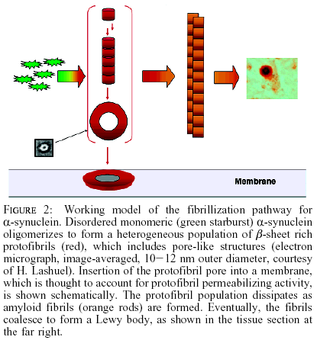
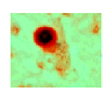
Model of α-synuclein fibrillization
Volles and Lansbury

Slide 19
Do oligomers damage membranes?

Slide 20
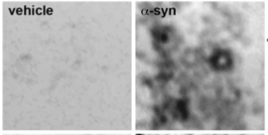
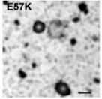
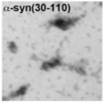
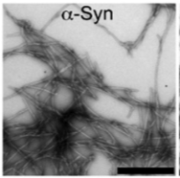
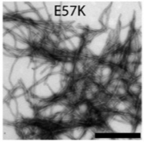
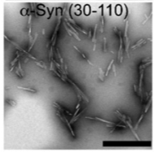
Fibrillar alpha-synuclein forms pore-like structures
E35
E57

Slide 21
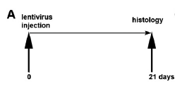
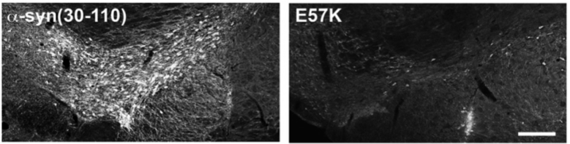
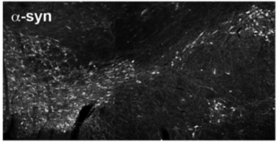
Overexpression of α-syn wt or variant is toxic
to dopaminergic neurons of SNPC
Tyrosine Hydroxylase staining

Slide 22
Disrupting the organization between α-helix and β-sheet strands improves the formation of oligomers, making the α-synuclein more toxic

Slide 23
Proposed mechanisms of toxicity of α-synuclein fibrils:
As lipid associated structure, they can disrupt membranes integrity, both plasma membranes and intracellular membranes causing:
*Disruption/damage of synaptic vesicles, altered release of neurotransmitter.
*Disruption/damage of ER and Golgi. This lead to ER stress and altered trafficking of proteins in the cell.
*Disruption/damage of mitochondria, causing mitochondrial stress, rupture, thus oxidation.
*Disruption/damage of proteasomes. Not clear whether this occurs because of a direct toxic function of α-synuclein on the UPP, or as a consequence of mitochondrial dysfunction.

Slide 24
Can α-synuclein oligomers cause mitochondrial damage in PD?

Slide 25
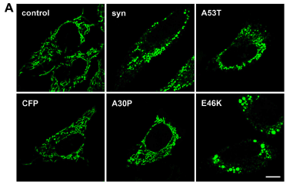
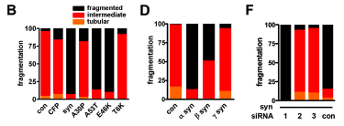
Overexpression of α-syn induces mitochondrial fragmentation

Slide 26
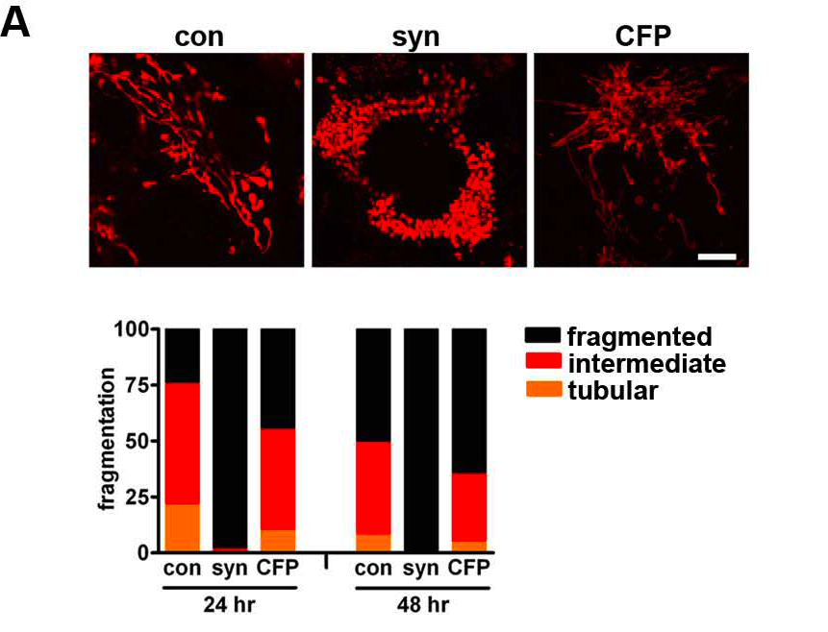
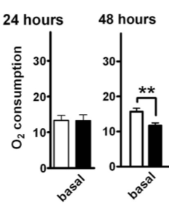
α-syn dependent mitochondrial fragmentation precedes
mitochondrial dysfunction…

Slide 27
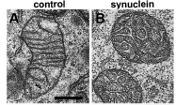
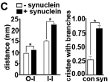
α-syn disrupts intramitochondrial structure in vitro and…
COS cells
O-I distance between outer and inner membrane
I-I distance between adjacent inner membranes

Slide 28
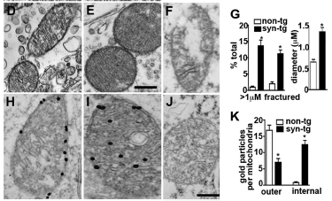
…in vivo
WT
α-syn Tg
α-syn Tg
Fractured and discontinuous outer membrane

Slide 29
Loss of physiological function
Or
Gain of toxic function?

Slide 30

α-syn KO does not affect mitochondrial integrity

Slide 31
Mechanism?

Slide 32
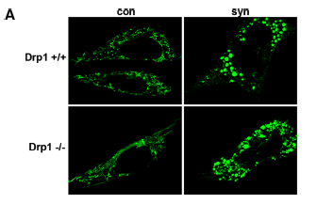
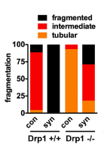
α-syn effects on mitochondrial fragmentation
are independent on Drp1

Slide 33
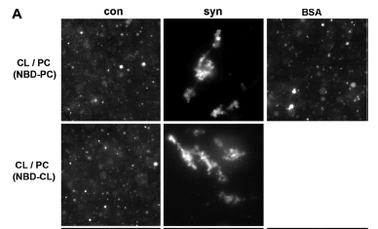
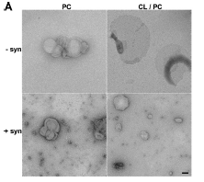
Recombinant oligomeric α-syn directly acts on membranes,
clustering and driving the fission of artificial membranes

